Slide 1
Sales Order and invoicing – desktop program
Jian Zhao
Dongfan Zhang

Slide 2
Background
From existing sales orders stored in database, enable user to issue the invoices
for chosen sales orders.
Once invoice is issued, it will be stored into database, and corresponding order status will be changed to complete

Slide 3
Main functions – what user can do - part1
Sales orders : query orders by customer name, order Id, order status
When one particular sales order is selected, the order items details will be showed in the sub section of the window.
Invoices: query invoices by date rage, customer name
When one particular invoice is selected , the invoice line item details will be displayed in the subsection of the window.

Slide 4
Main functions – what user can do - part2
Issue invoices, in issue invoices window, the notcomplete sales orders will be displayed, and user can search by customer name, and then choose the sales(one or several) order to issue invoice.
Invoices can be export to csv.
Invoice can be export to PDF.
Invoice can be send by email as attachment

Slide 5
Challenges and solution
Database design
Mapping the database designs (relational tables into java entity classes) by using composition/aggregation concepts
Write the DAO (data access object) according to program requirements
Working with Collections
Find out how to export invoice as PDF
Find out how to send emails via java

Slide 6
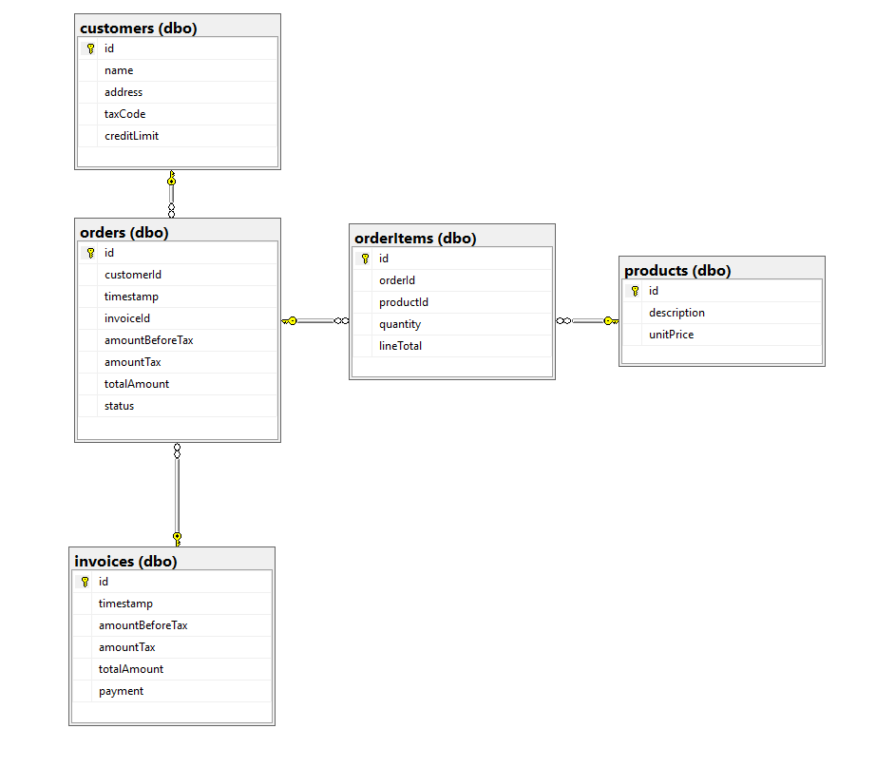
Database design – 5 tables

Slide 7
Tables mapping to java entity classes
Every table is turned into one entity class with their own attributes/ fields plus some compositions from other classes
Table Customers ➔ java Class Customer nothing special
Table products ➔ java Class Product nothing special
Table orderItems ➔ java Class OrderItem object Product for field product
Table orders ➔ java Class SalesOrder object Customer for field customer, Invoice for field invoice and list of orderItems for field items
Table invoice ➔ java Class Invoice Customer for customer, list of SalesOrder for salesOrder
?? Those objects or list of object as fields, my understanding is composition

Slide 8
Java class snippet
public class SalesOrder {
private int id;
private int customerId;
private java.sql.Date timestamp;
private BigDecimal amountBeforeTax;
private BigDecimal amountTax;
private BigDecimal totalAmount;
private OrderStatus status;
private List<OrderItem> items;
private Invoice invoice;
private Customer customer;
Public class Invoice {
private int id;
private java.sql.Date timestamp;
private BigDecimal amountBeforeTax;
private BigDecimal amountTax;
private BigDecimal totalAmount;
private BigDecimal payment;
private List <SalesOrder> salesOrder;
private Customer customer;

Slide 9
DAO (DATABASE class)
Using database connection transaction ensure the data integrity for issuing invoice (insert record into invoices table, meanwhile modify status to "complete" for orders through update orders table)
Overload getOrders method for adapting different search functionality
Using StringBulider instead of String for concatenation sql statements, which are easier readable and more elegant

Slide 10
Working with Collections
In our case, one invoice has one or several sales orders and one sales order can have multiple items. This often results to manipulate data collections.
Have not really did exercise in the class but have to use collections in this small program. Sample code as below:
List<Invoice> invoices = db.getInvoices(txtCustomerName.getText(), dateFrom, dateTo);
for (Invoice invoice : invoices) {
modelInvoices.addRow(new Object[]{
invoice.getId(),
invoice.getCustomer().getId(), invoice.getCustomer().getName(), invoice.getCustomer().getAddress(),
invoice.getAmountBeforeTax(), invoice.getAmountTax(), invoice.getTotalAmount(), df.format(invoice.getTimestamp())
});
}

Slide 11
Export to PDF
Using open source iText library for java
Using rectangle to implement block control for positioning paragraph text
Using table to display order items of invoices

Slide 12
Email with attachment using gmail

